Slide 1
eBPF for high performance network applications
Miklos Tirpak
miklos.tirpak@emnify.com

Slide 2
Content
What is eBPF?
Who uses that?
Instruction set
Trigger points
MAP types
Helper functions
Object pinning
Communication with the user space
Headroom
Tail calls
BPF verifier
EMnify use case

Slide 3
What is eBPF?
Extended Berkeley Packet Filter
Evolution of the classic BPF since 1992 (packet filter used by tcpdump)
cBPF is obsolete, automatically translated to eBPF
What does eBPF provide?
Instruction set,
infrastructure,
triggering points in the kernel

Slide 4
eBPF advantages
We can program the kernel without writing kernel modules
The verifier increases the safety
Instruction set is guaranteed to run on newer kernel versions
We can leverage the tools for user-kernel space communication, inspecting the data, sharing data between programs
eBPF programs can be re/-loaded atomically without interruption
The kernel stack can be extended or bypassed instead of completely replacing that (like DPDK)
This means significantly less development effort

Slide 5
Who uses eBPF?
Facebook:
Layer 4 Load-balancing is implemented with BPF
Replaces IPVS kernel module
Application can coexist with the load-balancer functionality
https://code.fb.com/open-source/open-sourcing-katran-a-scalable-network-load-balancer/
http://vger.kernel.org/lpc_net2018_talks/LPC_XDP_Shirokov_v2.pdf
https://github.com/facebookincubator/katran
Firewall with BPF replaces iptables
https://cilium.io/blog/2018/11/20/fb-bpf-firewall/

Slide 6
Who uses eBPF?
Cloudflare:
Constantly analyzes the traffic flow
Automatically detects and mitigates DDoS attacks
Layer 4 load-balancer distributes the traffic
https://blog.cloudflare.com/cloudflare-architecture-and-how-bpf-eats-the-world/
https://www.netdevconf.org/2.1/slides/apr6/bertin_Netdev-XDP.pdf

Slide 7
Who uses eBPF?
Cilium:
Network security filtering for Linux containers
Network-layer and application-layer security policies with eBPF
https://cilium.io/
https://github.com/cilium/cilium
Systemd:
eBPF is used for IP traffic accounting and access control
http://0pointer.net/blog/ip-accounting-and-access-lists-with-systemd.html

Slide 8
Who uses eBPF?
BPF Compiler Collection (BCC):
toolkit for creating efficient kernel tracing and manipulation programs
https://github.com/iovisor/bcc
Cloudflare + BCC: Prometheus BPF exporter
https://github.com/cloudflare/ebpf_exporter
Netflix:
Performance tuning and analysis with tools based on BPF
https://www.slideshare.net/brendangregg/how-netflix-tunes-ec2-instances-for-performance
https://www.youtube.com/watch?v=89fYOo1V2pA
iproute2, perf, Kubernetes, VALE switch, Suricata, ...

Slide 9
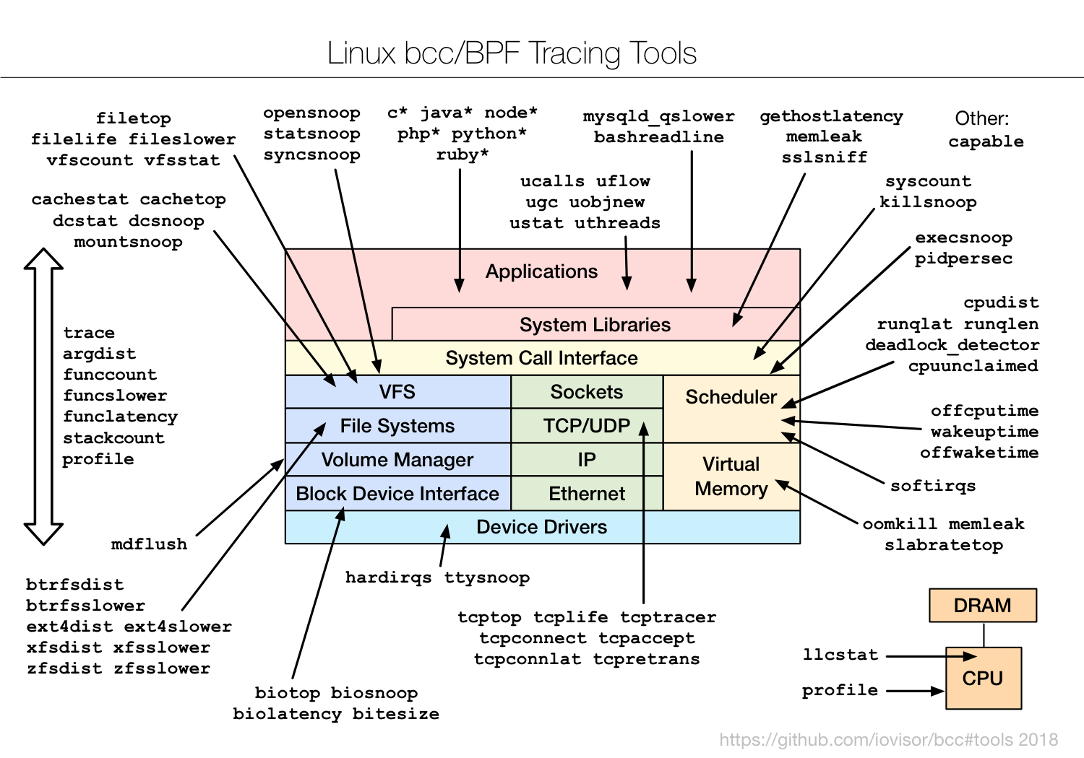
Who uses eBPF?

Slide 10
eBPF instructions
General purpose RISC instruction set (v1, v2, v3?)
64 bit registers r0-r10, 512 byte stack, max 4096 instructions
One-to-one mapping to HW registers on x86_64 and arm64
Event driven execution
LLVM supports restricted C to eBPF compilation
clang -O2 -g -Wall -target bpf -emit-llvm -c example.c -o example.bc
llc example.bc -march=bpf -mcpu=probe -mattr=+alu32 -filetype=obj -o example.o
In-kernel bytecode verifier
In-kernel JIT compiler
sysctl net/core/bpf_jit_enable=1
llvm
loader
JIT
Native machine code
Restricted C
BPF Bytecode
Verifier

Slide 11
Trigger points
eXpress Data Path (XDP)
The earliest trigger point with raw access to the packets, before sk_buff allocation
This is the fastest way to process packets with eBPF
XDP offload, in-driver hook, or generic xdp
Only ingress direction, there is no egress hook
Only 1 BPF program can be attached to an interface
ip link set dev eth0 xdpgeneric obj ip_fwd_kern.o
Actions:
XDP_DROP
XDP_PASS: pass up to the networking stack
XDP_TX: transport over the same NIC
XDP_REDIRECT: transmit over another NIC or to an AF_XDP socket

Slide 12
Trigger points
Traffic Control (TC)
After sk_buff allocation (parsed headers are already available)
There is no driver dependency
Ingress and egress hooks
Multiple BPF programs can be attached (but direct action is preferred)
tc qdisc add dev eth0 clsact
tc filter add dev eth0 ingress bpf da obj example.o
Actions:
TC_ACT_OK: terminate the pipeline and process the packet
TC_ACT_SHOT: drop the packet
TC_ACT_UNSPEC: execute the default action of TC
TC_ACT_PIPE: go to the next action
TC_ACT_RECLASSIFY: start classification from the beginning

Slide 13
Trigger points
System tracing and monitoring with hooks in:
kprobe
uprobe
tracepoint
perf event
usdt

Slide 14
Loading a BPF program
There are different ways to load a BPF program and attach that to a trigger:
From C code: Look up the sections, check the symbol table, attach to a trigger... check samples/bpf in the kernel sources
Iproute2 does all of these, programs can be loaded form the command line (include bpf_api.h)
Perf tool can load tracing BPF programs
BPF Compiler Collection (BCC) implements bindings for Python and LUA
bpftrace, ply, ...

Slide 15
The first BPF program
#include <linux/bpf.h>
#include <bpf_api.h> // from iproute2
// For header parsing
#include <linux/in.h>
#include <linux/if_ether.h>
#include <linux/ip.h>
__section("prog")
int xdp_ingress(struct xdp_md *xdp)
{
void *data_end = (void *)(long)xdp->data_end;
void *data = (void *)(long)xdp->data;
struct ethhdr *eth = data;
struct iphdr *iph;
// sanity check
if ((void*)(eth + 1) > data_end)
return XDP_DROP;
// skip anything else then ethernet+ipv4
if (eth->h_proto != htons(ETH_P_IP))
return XDP_PASS;
iph = data + sizeof(struct ethhdr);
if ((void*)(iph + 1) > data_end)
return XDP_DROP;
// Drop the ICMP packets
if (iph->protocol == IPPROTO_ICMP) {
return XDP_DROP;
}
return XDP_PASS;
}
char __license[] __section("license") = "GPL";

Slide 16
BPF MAPs
MAPs provide an efficient data storage in the kernel space
BPF programs have direct access to the data
User space programs have access to the values stored via system calls
MAPs can be shared between multiple BPF programs and the user space as well
They can be used for local data storage or intercommunication, for example:
Setting configuration values from the user space
Collecting statistics by the BPF program and reading them from the user space

Slide 17
MAP types
Data storage:
BPF_MAP_TYPE_HASH, BPF_MAP_TYPE_PERCPU_HASH,
BPF_MAP_TYPE_ARRAY, BPF_MAP_TYPE_PERCPU_ARRAY,
BPF_MAP_TYPE_LRU_HASH, BPF_MAP_TYPE_LRU_PERCPU_HASH,
BPF_MAP_TYPE_LPM_TRIE
BPF program pointers: BPF_MAP_TYPE_PROG_ARRAY
Perf events: BPF_MAP_TYPE_PERF_EVENT_ARRAY
CGROUPs: BPF_MAP_TYPE_CGROUP_ARRAY
Stack trace: BPF_MAP_TYPE_STACK_TRACE
Nested MAPS:
BPF_MAP_TYPE_ARRAY_OF_MAPS,
BPF_MAP_TYPE_HASH_OF_MAPS

Slide 18
MAP example - definition
#include <linux/bpf.h>
#include <bpf_api.h> // from iproute2
// Key
struct egn_gtp_key {
uint32_t ue_ip;
};
// Value
struct egn_gtp_value {
uint32_t local_teid;
uint32_t remote_teid;
uint32_t remote_tip;
uint16_t sequence_num;
// The structure must be explicitly padded to 32 bit multiple
uint16_t padding;
};
// map definition
struct bpf_elf_map egn_gtp_map __section("maps") = {
.type = BPF_MAP_TYPE_HASH,
.size_key = sizeof(struct egn_gtp_key),
.size_value = sizeof(struct egn_gtp_value),
.pinning = PIN_GLOBAL_NS,
.max_elem = 100000,
};

Slide 19
Helper functions
Helper functions are provided by the kernel
They can read/write data from/to the kernel, for example:
bpf_map_update_elem, bpf_map_lookup_elem
Macros are defined as BPF_CALL_0() … BPF_CALL_5() -- max 5 arguments supported
Availability depends on
BPF trigger point, for example: bpf_xdp_adjust_head
license

Slide 20
MAP example - lookup
#ifndef BPF_FUNC
# define BPF_FUNC(NAME, ...) \
(*NAME)(__VA_ARGS__) = (void *)BPF_FUNC_##NAME
#endif
// Most of the prototypes are already in iproute2
static void *BPF_FUNC(map_lookup_elem, void *map, const void *key);
static int gtp_verify_rcv(uint32_t saddr, uint32_t remote_tip, uint32_t teid)
{
struct egn_gtp_key gtp_key = { saddr };
struct egn_gtp_value *gtp_val;
int ret = 0;
gtp_val = map_lookup_elem(&egn_gtp_map, &gtp_key);
if (gtp_val) {
if (gtp_val->remote_tip != remote_tip
|| gtp_val->local_teid != teid) {
ret = -1;
}
} else {
ret = -1;
}
return ret;
}

Slide 21
MAP lifetime
The lifetime and accessibility of the MAPs can be controlled in different ways. They can be for example:
associated to the object
pinned to a pseudo file system
or the file descriptors can be transferred to a process environment (tc exec)

Slide 22
Object pinning
MAPs can be pinned into the pseudo file system /sys/fs/bpf/
The MAP is accessible via a file descriptor
The data remains in memory even if the BPF program is unloaded
PIN_OBJECT_NS = local to the object file
For example to share data between ingress and egress queues
PIN_GLOBAL_NS = global
For example to share data between the BPF program and a user space application
You can unlink the file to delete the MAP

Slide 23
MAP example – update from user space
struct egn_gtp_key gtp_key = { 0xc0a81097; };
struct egn_gtp_value gtp_value = {
.local_teid = 300,
.remote_teid = 400,
.remote_tip = 0xc0a81097, // 192.168.16.151
.sequence_num = 0,
.padding = 0,
};
int egn_gtp_map_fd = bpf_obj_get("/sys/fs/bpf/xdp/globals/egn_gtp_map");
bpf_map_update_elem(egn_gtp_map_fd, &gtp_key, &gtp_value, BPF_ANY);

Slide 24
bpftool
bpftool can be used to inspect or update the objects
You can find in the kernel sources: tools/bpf/bpftool
# ./bpftool prog list
16: xdp tag 748c6d2483dc926a
loaded_at 2019-06-01T19:00:36+0200 uid 0
xlated 3272B jited 1952B memlock 4096B map_ids 13,14,12,15
# ./bpftool map show id 13
13: hash flags 0x0
key 4B value 16B max_entries 1000 memlock 90112B
# ./bpftool map dump id 13
key: 02 00 63 0a value: 2c 01 00 00 90 01 00 00 97 10 a8 c0 00 00 00 00
Found 1 element

Slide 25
Passing data to the user space
MAPs can be periodically queried – not very efficient with big amount of data
Perf events:
Data can be passed through a lockless per-CPU ring buffer to the user space
User space application can read the data via a file descriptor
This can be useful for:
triggering higher level application logic, update DB with statistics...
sending data about the events to monitor the kernel
simply issuing log messages

Slide 26
Headroom
XDP allocates extra room before the data
struct xdp_buff {
void *data;
void *data_end;
void *data_meta;
void *data_hard_start;
….
Head can be adjusted, for example headers can be added/removed: bpf_xdp_adjust_head()
Metadata can be added – information can be passed to other BPF programs

Slide 27
Tail calls
A BPF program can jump into another one
The execution is not returned to the caller
Only programs of the same type can be tail called
BPF_MAP_TYPE_PROG_ARRAY holds the file descriptors to the programs
bpf_tail_call() jumps into the new program

Slide 28
BPF Verifier
The in-kernel verifier examines the BPF code to protect the system
A valid, successfully compiled C code can still be rejected
Graph validations are performed to guarantee that the programs always terminate
No loops are allowed (unroll them; bounded-loop support is on the way)
No global variables are supported (use maps, static global support is on the way)
No constant strings or arrays are supported
Pointer arithmetic is disallowed

Slide 29
BPF Verifier – my impressions
The verifier is very picky
Hard to understand the problems without looking at the instructions in detail
12: (71) r1 = *(u8 *)(r1 +23)
invalid access to packet, off=23 size=1, R1(id=0,off=0,r=14)
R1 offset is outside of the packet
Use llvm-objdump –S … to locate the rejected instructions
The verifier is sometimes even buggy

Slide 30
Readings
https://cilium.readthedocs.io/en/latest/bpf/
https://github.com/zoidbergwill/awesome-ebpf
https://conferences.sigcomm.org/sigcomm/2018/files/slides/hda/paper_1.2.pdf
https://www.slideshare.net/brendangregg/linux-bpf-superpowers
https://blogs.oracle.com/linux/notes-on-bpf-1 -2, … -6
https://github.com/iovisor/bcc/tree/master/docs
https://ferrisellis.com/content/ebpf_syscall_and_maps/
http://www.brendangregg.com/ebpf.html
Man pages: bpf(2), tc-bpf(8), bpf-helpers(7)

Slide 31
Example programs
Kernel sources: samples/bpf/
Iproute2 sources: examples/bpf/
BCC: examples/ or tools/

Slide 32

EMnify use case
Internet
EGN
GGSN/PGW
GTP-C / GTP-U
EGN terminates the GTP tunnels that carry the data traffic
The control and data planes are cleanly separated
The user's subscription plan includes the allowed traffic
The data plane performs GTP-U encapsulation/decapsulation and accounting
GTP-U is a fairly simple protocol
Cutting off the data flow does not have to be 100% precise

Slide 33
EMnify use case
Ethernet
IP
UDP
GTP-U
User Data (L3 + L4 +...)
Data plane: Prototype data plane implementation with XDP
1st step: Identify the GTP-U encapsulated packets
2nd step: Identify the packets towards the UEs
Everything else is passed to the network stack
Is it from a known UE?
Strip off the IP + UDP + GTP-U headers
Record the received bytes
Is it targeted to a known UE?
Add IP + UDP + GTP-U headers
Record the sent bytes
Control plane:
It inserts the UE addresses and tunnel details into a hash table
Passes configuration to the BPF program
Populates the ARP table
Periodically checks the usage limits
Place for improvement: Trigger a perf event from BPF when the limit is reached

